Slide 1
OpenShift DO280 – Day 1

Slide 2
Day 1 Objectives
Understand declarative vs imperative
Deploy apps using YAML manifests
Expose applications (Service + Route)
Use ConfigMaps and Secrets
Combine CLI and Web Console

Slide 3
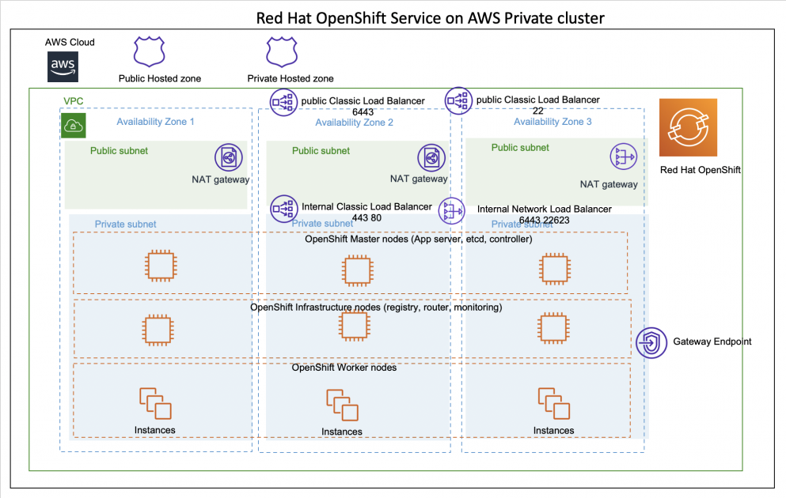
Current Architecture

Slide 4

Current Infa
3. OpenShift Cluster Layer
Control Plane (Masters)
3 nodes (High Availability)
Responsibilities:
API Server
Scheduler
etcd (cluster database)
Controllers
Worker Nodes
3 nodes
Where applications run
1. Student Layer (Access Layer)
Your laptops
Browser / CLI (oc)
Connected over internet
2. AWS Cloud Layer
“This is where everything actually runs”
AWS region: us-east-1
VPC (private network)
EC2 instances
Load balancers (auto-created by OpenShift)

Slide 5
Current Infa
4. Networking Layer
OpenShift SDN (OVN-Kubernetes)
Internal pod network
Service network
External routes
5. Storage Layer
AWS EBS (gp3 storage class)
Dynamic volume provisioning
6. Ingress / Routing Layer
OpenShift Router (Ingress controller)
Handles:
External traffic
SSL termination
Load balancing

Slide 6
OpenShift Cluster Architecture
Control Plane (Masters)
Worker Nodes
API Server, Scheduler, etcd
Operators manage platform components
Example: 3 masters + 3 workers

Slide 7
Declarative vs Imperative
Imperative: Execute commands directly
Declarative: Define desired state in YAML
OpenShift reconciles actual vs desired
Preferred approach for production

Slide 8
Difference
Imperative (Command-Based) | Declarative (State-Based)
You tell HOW to do | You define WHAT you want
Step-by-step execution | Desired state definition
Example: oc scale --replicas=3 | Example: replicas: 3 in YAML
Manual & immediate action | Automated reconciliation
Not repeatable easily | Fully repeatable (idempotent)
Error-prone in production | Reliable for production
Hard to track changes | Version controlled (GitOps)
Used for quick fixes/debugging | Used for deployments & CI/CD

Slide 9
YAML Manifest Structure
apiVersion
kind
metadata
spec
Defines desired state of resources

Slide 10
Deploy Applications from Manifests
Use 'oc apply -f'
Creates or updates resources
Ensures consistent deployments
Supports version control and automation

Slide 11
Services and Routes
Service: Internal access inside cluster
Route: External access via OpenShift
Load balancing handled automatically
Example: Expose nginx app

Slide 12
ConfigMaps and Secrets
ConfigMap: Non-sensitive configuration
Secret: Sensitive data (passwords, tokens)
Used as environment variables or files
Separates config from application code

Slide 13
Hands-on Lab: Cluster Verification
oc get nodes
oc get clusteroperators
Verify cluster health before deployment

Slide 14
Hands-on Lab: Deploy Application
Create deployment.yaml
oc apply -f deployment.yaml
Verify pods using 'oc get pods'

Slide 15
Hands-on Lab: Expose Application
oc expose deployment nginx
oc expose svc nginx
Access app via route URL

Slide 16
Hands-on Lab: Scale Deployment
Update replicas in YAML
oc apply -f deployment.yaml
Verify scaling using 'oc get pods'

Slide 17
Hands-on Lab: ConfigMap & Secret
oc create configmap
oc create secret
Use in applications for configuration

Slide 18
Helm vs OpenShift Templates (Quick Comparison)
Feature | Helm | OpenShift Templates
Purpose | Package manager for Kubernetes | Native templating in OpenShift
Scope | Works on any Kubernetes | Only OpenShift
Language | Go templating ({{ }}) | Parameter substitution (${})
Reusability | Very high (charts) | Limited
Versioning | Built-in (chart versions) | Manual
Dependency mgmt | Yes | No
Ecosystem | Huge (Helm Hub) | Small
GitOps friendly | Yes | Limited
Complexity | Medium | Easy
Real-world usage | Industry standard | Mostly legacy

Slide 19
Hands On

Slide 20
Day 1 Summary
Declarative model is key in OpenShift
YAML defines application state
Templates & Helm Based Packages
ConfigMaps and Secrets manage config
Hands-on builds real understanding

